Slide 1
IBM SMARTINTERNZ - NALAIYA THIRAN
PLASMA DONOR APPLICATION
BY
GOKUL A P (917719C024)
PRITHIVI RAJ V(917719C073)
SHIVANESH(917719C095)
VARUN PRATAP SINGH (917719C112)

Slide 2
Problem Statement
Patients with severe liver disease or numerous clotting factor deficits, as well as those who have undergone trauma, burns, or shock, frequently get plasma. The patient's blood volume is increased as a result, which can aids in blood coagulation and helps to prevent shock. The number of people with Covid-19 infection has increased, as has the demand for the plasma of patients who have recovered.
Plasma donation saves lives, and donors' and blood/plasma facilities' communication is key to this. Smart apps are increasingly viewed as a crucial communication tool, and if they are created with the users' requirements and preferences in mind, plasma donation could make the best use of them.

Slide 3
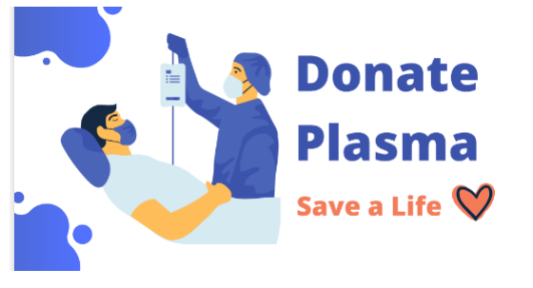

Slide 4
PLASMA DONOR APPLICATION
Plasma is commonly given to trauma, burn and shock patients, as well as people with severe liver disease or multiple clotting factor deficiencies. It helps boost the patient's blood volume, which can prevent shock, and helps with blood clotting. With the number of people affected by Covid-19 infection, the demand for the plasma of recovered patients has also gone up tremendously.
We plan to make a User-friendly application for users who are in need for plasma or who wish to donate plasma to anyone who are in need. The donation centre staff focused on the educational features of the app and emphasized the importance of the app providing statistics and sending notifications and reminders to donors.

Slide 5
Technologies Used
User Interface - HTML,CSS, PYTHON FLASK
2) Email Services – Sendgrid API
Environment – Docker Container
Cloud Database- IBM DB2
Infrastructure- Kubernetes

Slide 6
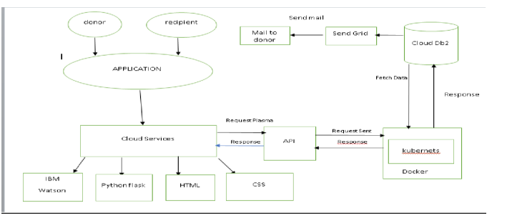
Technical Architecture

Slide 7
Deploying the Application on IBM Cloud
Step 1: Built Plasma Donor Application using Flask
Step 2: Dockerized the Flask Application
Step 3: Pushed the Docker image to Container Registry
Step 4: Created a Kubernetes cluster to deploy containarized application
Step 5: Created a deployment yaml file with docker image.
Step 6: Deploy to Kubernetes.

Slide 8
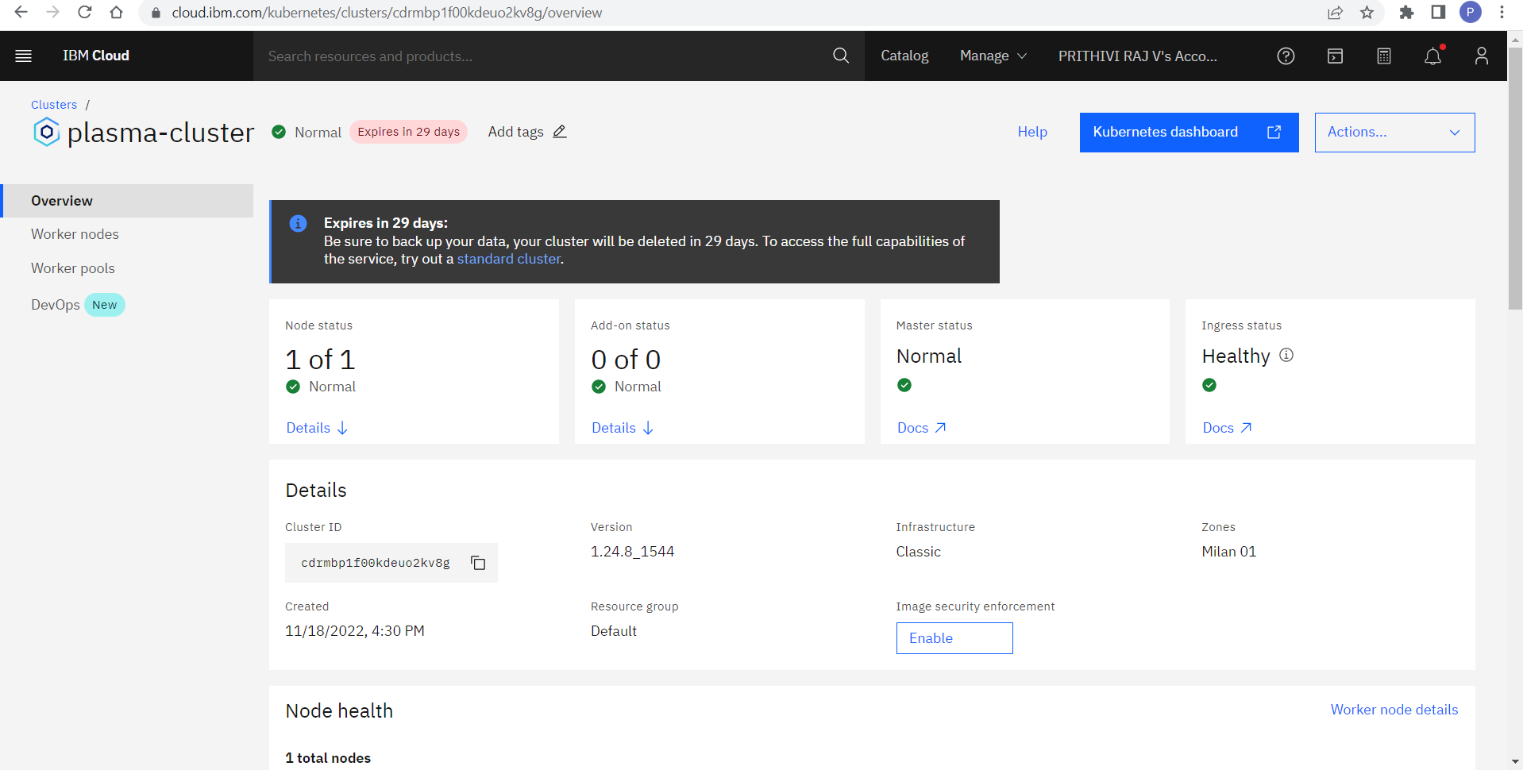
IBM KUBERNETES CLUSTER

Slide 9
WORKING OF APPLICATION
FUNCTIONS | INFORMATION
User Registration | Registration to the application as donor/requester
User Confirmation | Confirmation via Email
User Login | Login using Registered Credentials
Sent Request | If plasma is required, the requester will login and request for the blood group required
Alerting Donor | An Alert email is sent to the donor of that blood group

Slide 10
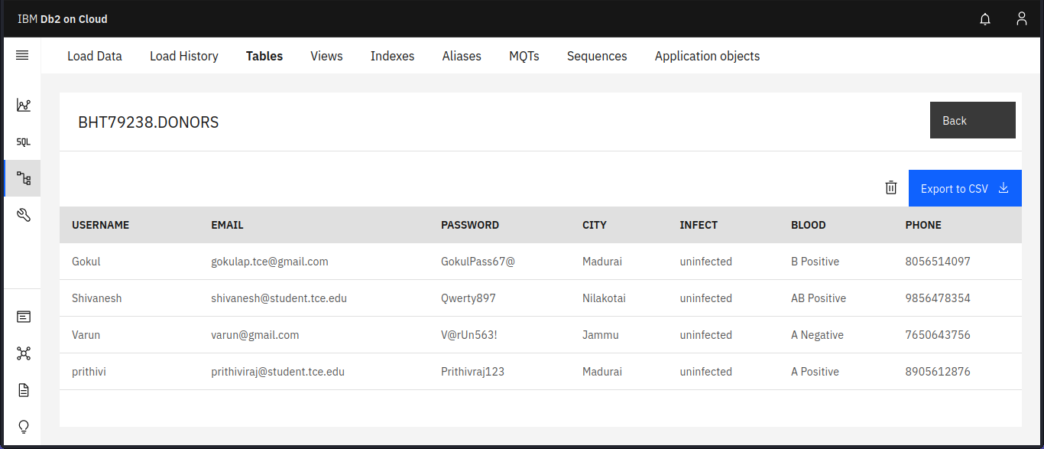
DATABASE IMAGES

Slide 11
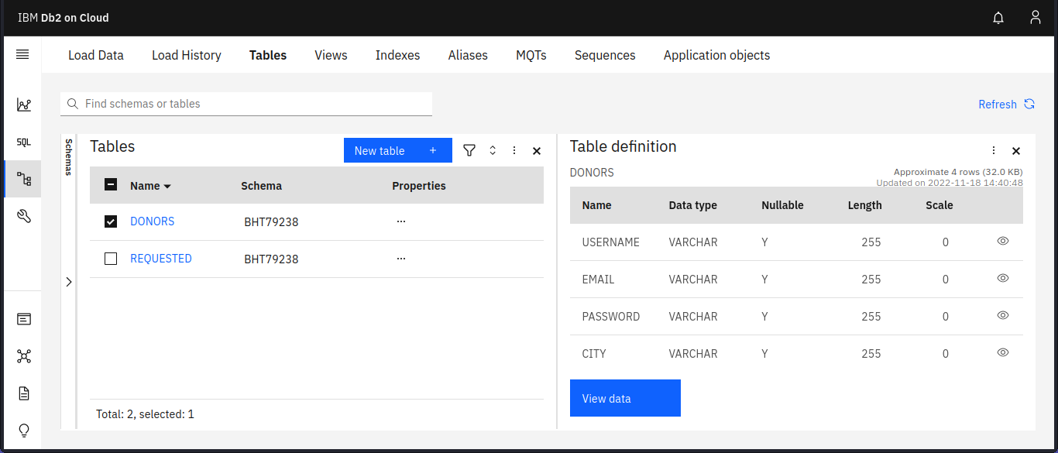
USING DB2 SERVICE

Slide 12
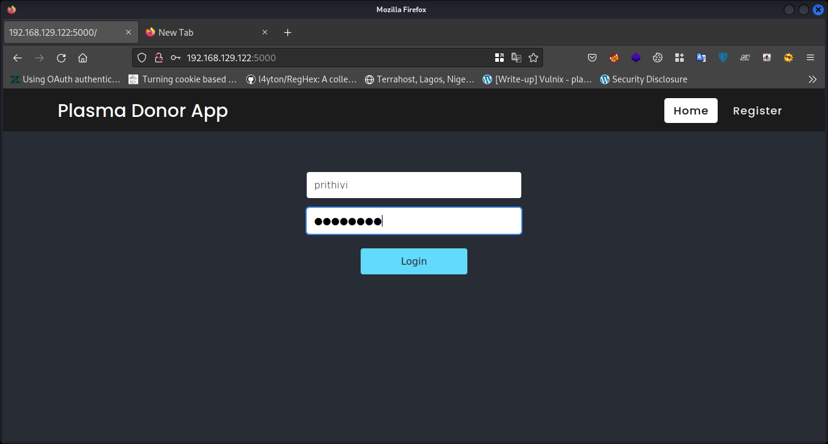
Login Page

Slide 13
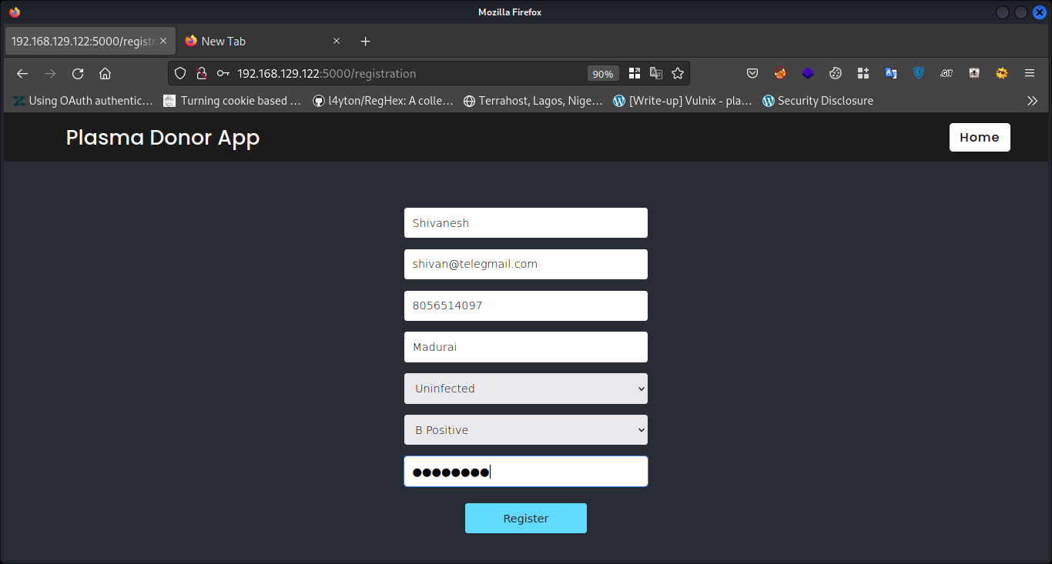
Register Page

Slide 14
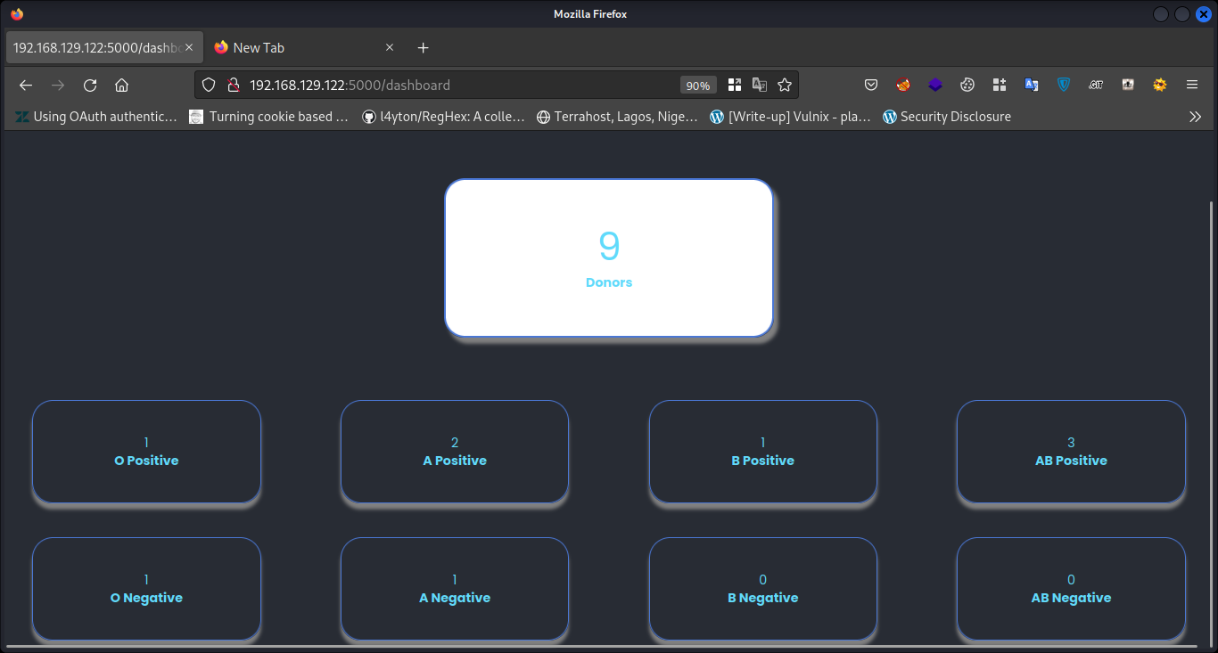
Donor Application Dashboard

Slide 15
DEMO LINK
IBM-Plasma-Donor-App-demo.mp4 - Google Drive

Slide 16
THANK YOU

